Slide 1
PHS 2000 Econometric Methods 2025 Lecture 3 Regression Discontinuity Design
Maggie McConnell
Department of Global Health and Population
Harvard T. H. Chan School of Public Health

Slide 2
Plan of presentation
Explaining Regression Discontinuity Designs (RDD)
Key assumptions
Testing the assumptions (where possible)
Model choices in estimation (lots of choices)
Examples (the importance of pictures)
Some practical tips

Slide 3
Unobserved variables and observational biases
Recap: omitted variable bias, endogeneity can be a big problem in estimating causal effects
What can we do?
RCTs – but RCTs are costly, not always desirable and may not be the right design for questions around local, state or federal policy
IV estimation – but good instruments are not easy to find and IV only valid under very strict assumptions and face challenges
Many IV design don’t feel likely to have a high degree of external validity

Slide 4
Regression Discontinuity Designs (RDD) -- intuition
RDDs: alternative strategy to estimate causal effects in observational data
The idea is relatively simple: for many variables of interest, institutional rules or laws have generated arbitrary eligibility criteria, which means that the probability of receiving exposure to a given variable “jumps” at a certain point in a continuous distribution
These “jumps” or discontinuities provide us with quasi-experimental variation that we can explore to pin down causal effects of interest
Econometrics by graphs

Slide 5
Example 1 for discontinuities: Scholarship
In general, scholarships are strongly correlated with other variables of interest such as academic performance or parental background
Very hard to determine the impact of scholarships on later life success
In many states, scholarship rules are very strict
For example, if GPA > x, a student gets the scholarship
If we compare students just below the threshold to students just above the threshold, the only difference in their later life outcomes should be scholarship since both groups should be otherwise similar

Slide 6
Example 2A: Guidelines -- birthweight
RDD designs can even work in settings where there is a sufficiently powerful informal or non-binding rule
This is especially true in medical care settings where non-binding guidelines common
Example: Very low birth weight (birth weight > 1500) for infants
No sharp discontinuity in medical risk
What ”treatment” would you be analyzing with a design comparing infants just above and below the VLBW threshold?
What outcomes would you be interested in analyzing?

Slide 7
Example 2B: Guidelines – pregnancy age
Another example: Advanced maternal age (age>35) for pregnancy (“geriatric pregnancy”)
Your health doesn’t deteriorate the minute you turn 35
Threshold used to decide who should get genetic testing in 1979
Now commonly used as rule of thumb / billing justification for high-risk pregnancies
By comparing patients just below this threshold to patients just above it, you can infer how much “more intensive” care during pregnancy affects pregnancy outcomes

Slide 8
Many other examples of RDD in the literature
Question: What is the impact of a longer postpartum stay on hospital readmission?
Running variable: time of birth
threshold: midnight (infants born just after get an additional day of paid care)
Question: What is the impact of aging into Medicare on racial / ethnic differences in access to health care?
Running variable: age
threshold: 65
Question: What is the impact of having a female mayor on mortality from COVID-19?
Running variable: female vote margin
threshold: 0%

Slide 9
RDD – how it works
Treatment is discontinuous in a continuous “running variable”
i.e. GPA, birth weight, vote share, age, time
We examine only individuals in a small window around the threshold and compare treated and controls
Why only in a small window?
If confounders are continuous in the running variable, they should look similar for treated and control in the small window

Slide 10
Under what conditions can we estimate RDD?
Conditions
- A continuous eligibility index: a continuous measure on which the population of interest is ranked (i.e. test score, health indicator, age).
A clearly defined threshold point: a point on the index above or below which the population is determined to be eligible for the program

Slide 11
What assumptions required for RDD to be valid?
Key assumption
Continuity assumption: The only thing that causes a discontinuity above and below the threshold is the likelihood of program participation/eligibility
Implications of this assumption
Individuals can’t be able to manipulate the running variable in order to increase the chances of being included / excluded
Individuals close to the threshold should be very similar, on average, in observed and unobserved characteristics
There’s no other competing intervention or policy change occurring around the threshold
Stop for questions

Slide 12
RDD, RCTs, and IV estimation
Under ideal conditions, RDDs are very similar conceptually to RCTs: if it is true that treatment assignment is close to “random” within the analyzed range, then RDDs become a quasi-experiment
RDDs can also be seen as a special case of IV estimation
Under the RDD assumption, we know that there is an increase in the treatment at the threshold, and we explore this exogenous variation in the treatment to identify the causal effect of interest
Key question: How plausible is it that the threshold affects the outcome only through treatment?
Recall, this is the similar to the exclusion assumption in an IV setting

Slide 13
How do we feel about the identifying assumption in these cases
How do we feel about the identifying assumption in these cases?
LBW designation for more intensive newborn care and follow-up
”running variable”: birth weight
”threshold”: 1500 grams
“treatment”: intensive medical care
Advanced maternal age for more “intensive” medical treatment
“running variable”: maternal age
“threshold”: 35
“treatment”: intensive medical care
Births around midnight for longer postpartum stay
“running variable”: timing of birth
”threshold”: midnight
“treatment”: longer hospital stay
Close election for representation by a female mayor
“running variable”: difference in vote shares from top candidates
“threshold”: 0
“treatment”: female mayor

Slide 14
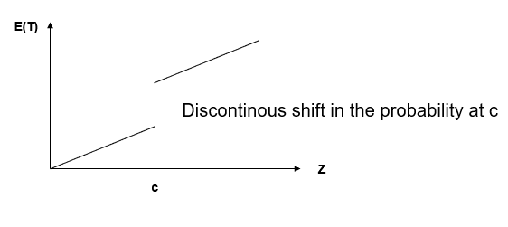

Critical threshold for treatment
Assume that there is a continuous variable z which determines eligibility for treatment discontinuously at some threshold ($c$)
$$\lim_{Z↓c}\operatorname{Pr}\left(T_{i}=1\right)≠\lim_{Z↑C} Pr⁡(T_{i}=1)$$

Slide 15
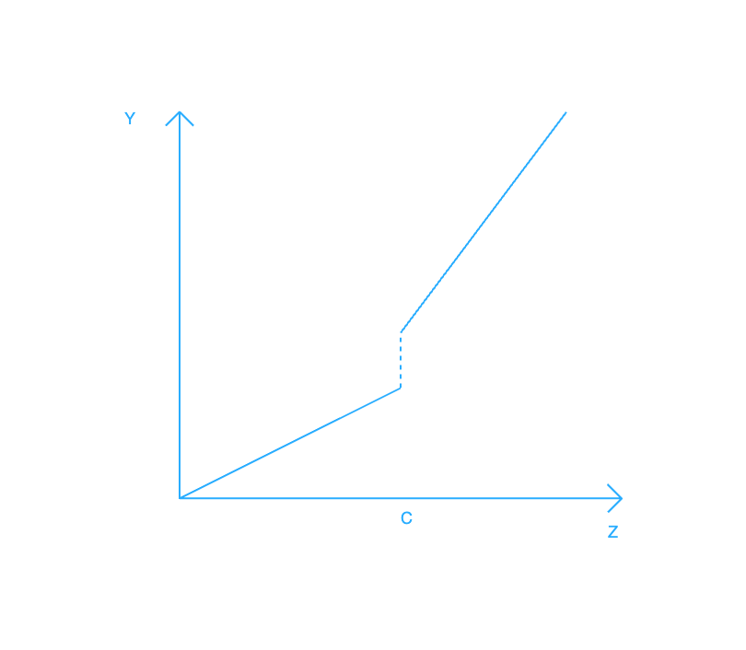
Are there “discontinuities” in outcomes?
If we think we have met the conditions for valid RDDs we can look for “jumps” in outcomes
We could observe shift in intercept and change in slope of relationship

Slide 16
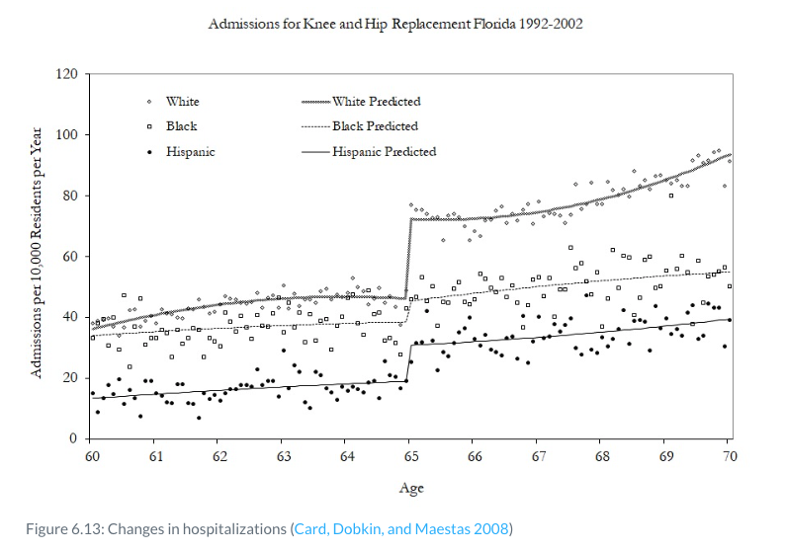
Example – looking for discontinuities in outcomes
What treatment/intervention/policy is being evaluated?
How do we feel about the assumptions for RDD to be valid in this case?

Slide 17
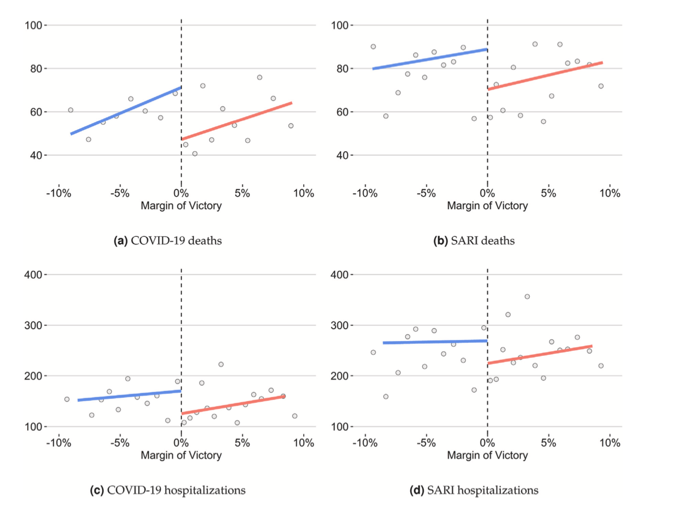
Example – looking for discontinuities in outcomes
Remember – RDD is econometrics by graphs!

Slide 18
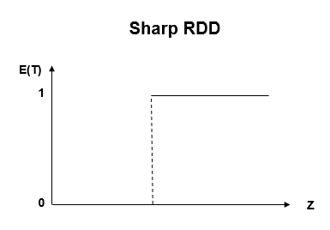
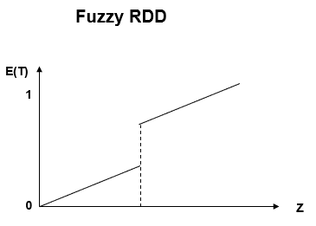
Sharp discontinuities vs. fuzzy discontinuities
With sharp discontinuities, the probability of receiving treatment at the threshold goes from 0 to 1
With fuzzy discontinuities, the change in probability of receiving treatment at the threshold is less than 1

Slide 19
Sharp or fuzzy
Would these be sharp or fuzzy RDD?
LBW designation for more intensive newborn care and follow-up
Advanced maternal age for more “intensive” medical treatment
Births around midnight for longer postpartum stay
Close election for representation by a female mayor

Slide 20
Sharp or fuzzy
Would these be sharp or fuzzy RDD?
LBW designation for more intensive newborn care and follow-up
Advanced maternal age for more “intensive” medical treatment
Births around midnight for longer postpartum stay
Close election for representation by a female mayor (hopefully)

Slide 21
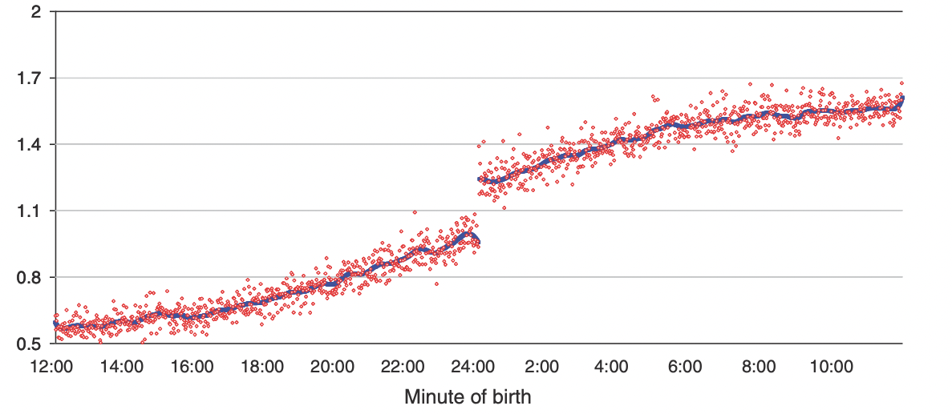
Example of fuzzy RDD – length of stay after birth

Slide 22
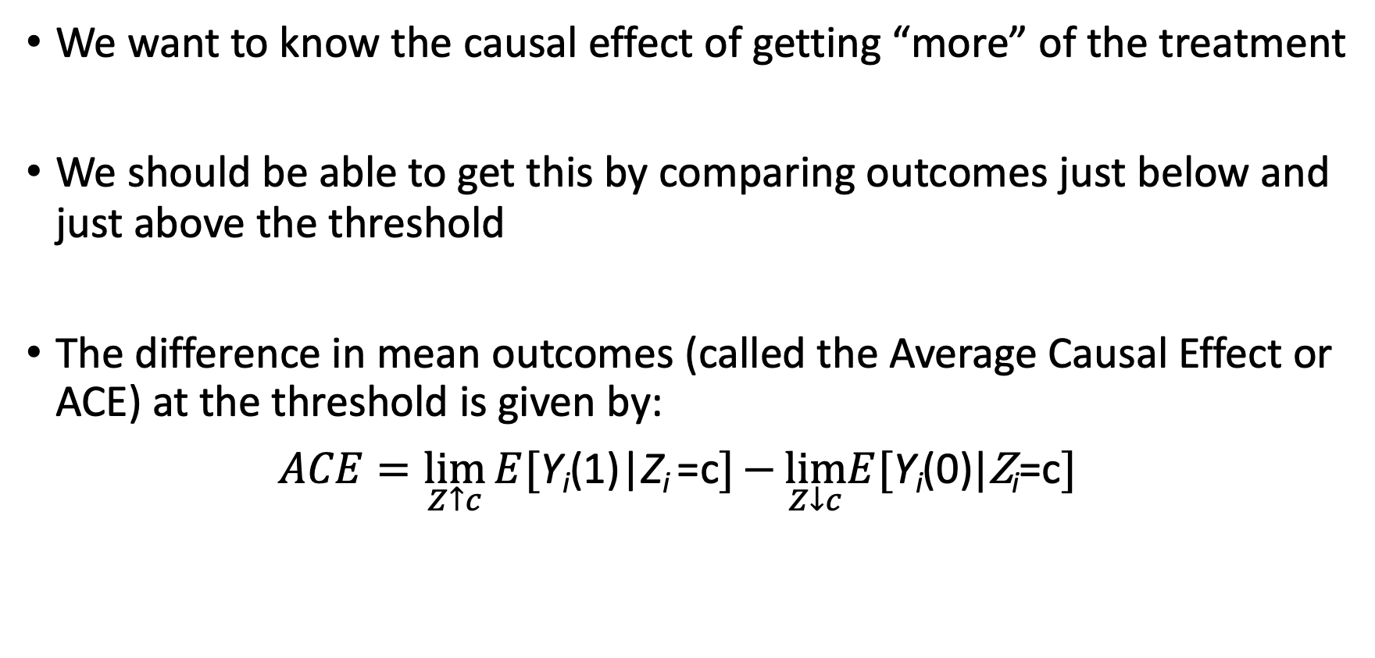
Identifying the causal effect
We want to know the causal effect of getting “more” of the treatment
We should be able to get this by comparing outcomes just below and just above the threshold
The difference in mean outcomes (called the Average Causal Effect or ACE) at the threshold is given by:
$ACE=\lim_{Z↑c}{E[\text{Y}\text{i}\text{(}\text{1}\text{)}\text{|}\text{Z}\text{i}}\text{=}\text{c}]−{\lim_{Z↓c}E[\text{Y}\text{i}\text{(}\text{0}\text{)}|\text{Z}\text{i}\text{=}\text{c}]}$

Slide 23
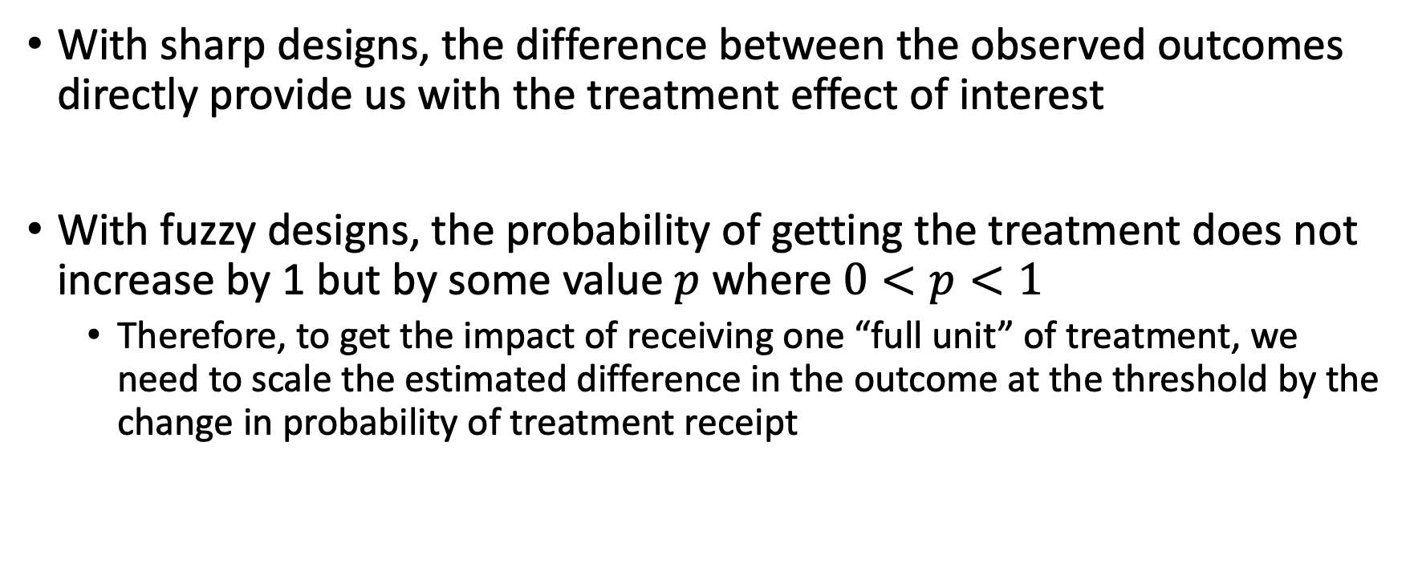
Interpreting sharp vs. fuzzy designs
With sharp designs, the difference between the observed outcomes directly provide us with the treatment effect of interest
With fuzzy designs, the probability of getting the treatment does not increase by 1 but by some value $p$ where $0<p<1$
Therefore, to get the impact of receiving one “full unit” of treatment, we need to scale the estimated difference in the outcome at the threshold by the change in probability of treatment receipt

Slide 24
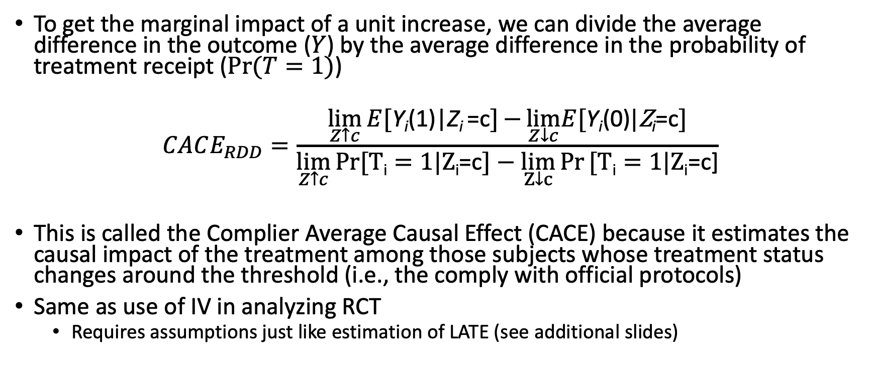
Complier Average Causal Effect (CACE)
To get the marginal impact of a unit increase, we can divide the average difference in the outcome ($Y$) by the average difference in the probability of treatment receipt ($Pr⁡(T=1)$)
$$CACE_{RDD}=\frac{\lim_{Z↑c}{E[\text{Y}\text{i}\text{(1)|}\text{Z}\text{i}}\text{=}\text{c}]−{\lim_{Z↓c}E[\text{Y}\text{i}\text{(0)}|\text{Z}\text{i}\text{=}\text{c}]}}{\lim_{Z↑c}{\operatorname{Pr}{[\text{T}\text{i}=1|\text{Z}\text{i}\text{=}\text{c}]}−\lim_{Z↓c}{Pr⁡\text{[}\text{T}\text{i}=1|\text{Z}\text{i}\text{=}\text{c}\text{]}}}}$$
This is called the Complier Average Causal Effect (CACE) because it estimates the causal impact of the treatment among those subjects whose treatment status changes around the threshold (i.e., the comply with official protocols)
Same as use of IV in analyzing RCT
Requires assumptions just like estimation of LATE (see additional slides)

Slide 25
Conceptual challenge 1: Plausibility of identifying assumption
The critical concept underlying RDD is that the ONLY thing that has a discontinuity around the threshold is the treatment
I.e. not expected outcomes or characteristics of the population
This is plausible in many scenarios, but will be violated if:
Subjects can manipulate the assignment variable
Program administrators can manipulate the assignment variable
Other major changes also happen at the threshold
Quasi-random assignment assumption is more likely to be plausible if subjects don’t know their “score” / only have a noisy signal
We can check this assumption empirically by looking at density distributions of the running variable around the threshold – should be smooth
“Bunching” means that we may have manipulation
Goodhart’s law: any measure used for policy becomes distorted

Slide 26
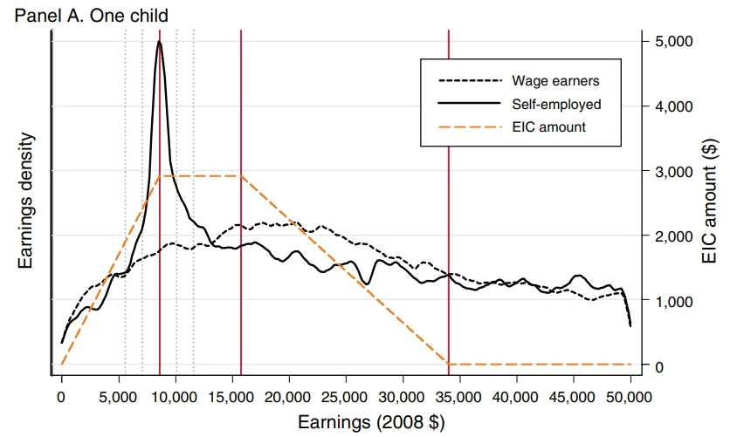
Example of violation of identifying assumption

Slide 27
Conceptual challenge 2: External validity
RDDs focus on causal effects for very specific populations close to the threshold (e.g. well-performing students close to getting scholarships)
The ACE estimator will give us the average causal impact among subjects of this “type,” which may not be representative of the ATE in the population
The CACE will give us the average impact among subjects of this type who “comply” with policy, i.e., do not get the treatment below the threshold and get it above

Slide 28
How do we feel about external validity for these cases?
Who is the population near the threshold? Who are the compliers?
LBW designation for more intensive newborn care and follow-up
Advanced maternal age for more “intensive” medical treatment
Births around midnight for longer postpartum stay
Close election for representation by a female mayor

Slide 29
Conceptual challenge 3: Bandwidth and counterfactual outcomes
Estimate gives the average causal effect as we limit the sample to those very close to the threshold
But we need to have a reasonable bandwidth to have a decently sized sample and reasonable standard errors
As we widen the bandwidth the there is greater potential for confounding –consistency result only holds in the limit as bandwidth tends to zero
With a wider bandwidth some modeling of functional form might come into play
Very important to have the correct functional form relationship between X and Y or else we could “find a discontinuity” where there isn’t one...

Slide 30
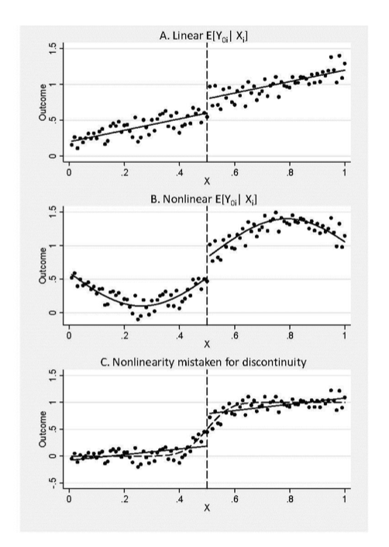

Slide 31
Formal RDD Assumptions
Requires takings limits as we narrow the window around the threshold.
Can estimate ACE if we assume treatment effect is homogenous (ACE)
Continuity of outcome at threshold if untreated
Discontinuity in treatment at threshold
If effect is heterogeneous we need more assumptions to estimate complier average causal effect (CACE) – similar to IV case
See additional slides for details

Slide 32
Advanced topics in RDD
The bandwidth choice is flexible
Try different bandwidths and plot estimates (and standard errors) as a function of bandwidth
Optimal bandwidth selection on some criteria such as confidence intervals is available. This may prevent cherry picking results.
Degree of polynomial in running variable around bandwidth is flexible
With very small bandwidth, linear form is common; with wider bandwidths, higher order polynomials or non-parametric function should be estimated as well
Method of calculating standard errors is flexible
Different formula have been developed – at least 4.
Lots of technical issues, but graphs are key. We should be able to see the results in pictures to be convincing!
This is a method that needs a LOT of data for robust estimates!

Slide 33
Practical Tips: Assessing the Validity of RDD
Show characteristics (SES, age...) are balanced around threshold.
One way to do this is to estimate the same main regression as RD but your “outcomes” are the covariates. Look for jumps near the threshold.
Similar to balance tables in RCTs
Estimate causal effect using different bandwidths and check stability of estimates — instability suggests wrong functional form
3) Look for “bunching” in the running variable around threshold
Should not be extra mass in distribution near threshold
Can use McCrary 2008 density test to test this formally
4) Estimate “false threshold”
Should not find significant effects at the wrong threshold

Slide 34

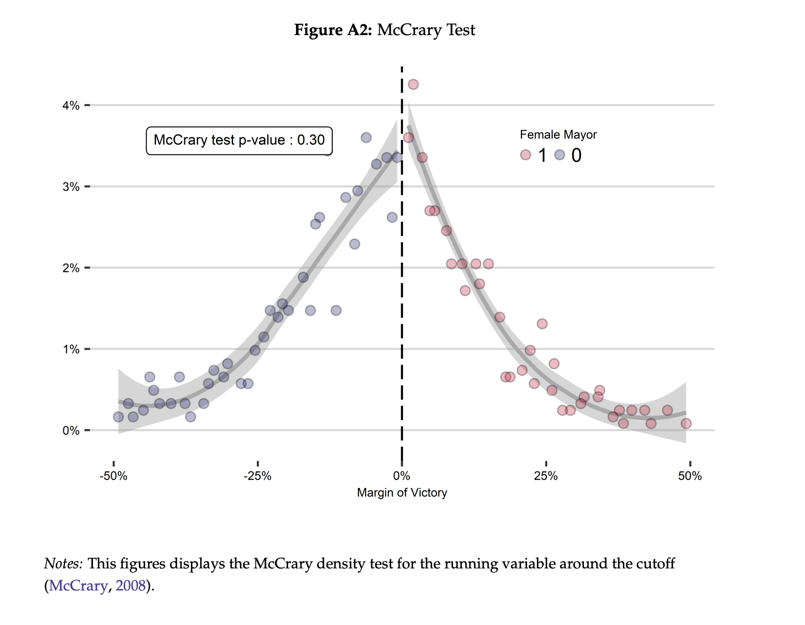
Assessing bunching

Slide 35
Age as a running variable – special issues
What do you think are some challenges of using age in an RDD?
Some policies are age dependent – old age pension, Medicare eligibility
Age cannot be manipulated – but can people report false ages to get access
Several policies may change at same age
Age 65: Medicare, some pensions, senior discounts.
Change at 65 is not random and is foreseeable. We may see actions below 65 in anticipation of treatment at age 65
Consumption smoothing of pension income
Delaying health care utilization until Medicare access
Is that likely to be a concern in the case of “advanced maternal age”?

Slide 36
What are we estimating?
If we get through all these checks, we can feel more confident assessing changes in outcome variables at the threshold as:
The average causal effect of the program at the threshold for sharp RDD
The impact of crossing the threshold (kind of an analogy to ITT) for fuzzy RDD
With some assumptions we can scale this by the change in the probability of participating in treatment at the threshold to get the Complier Average Causal Effect of the program at the threshold
Compliers: Those who get the treatment only because they are above the threshold
Can we identify compliers in the data?

Slide 37
IV vs. RDD
Both IV and RDD strategies explore random variations generated by specific programs or thresholds
While this variation could be randomly distributed across the entire population (like the variation in exposure generated by an RCT), most IVs and RDD explore variations generated by government laws or other quasi-random rules
If treatment impact is heterogeneous, the estimates are not necessarily the average treatment effects for the population.
We refer to RDD estimates as ACE or CACE, and to IV estimates as LATE.
Big advantage of RDD – relies on continuity of missing covariates with z, NOT on no correlation between covariates and z.

Slide 38
Strength of RDDs
RDD models have many potential applications
The assumption that treatment assignment is discontinuous around a very specific threshold is plausible in many settings and can be tested
The degree to which populations are the same to the “left” and “right” of the threshold can be tested empirically – test balance of observables
The plausibility of RDD is possible to assess visually – can lend strength to conclusions
RDD estimate the causal effect of treatments in practice, which may be very different from the controlled environments generated for RCTs

Slide 39
RDD summary
RDD offers a conceptually very elegant approach to identify causal effects in observational data
Like IV, RDD often identifies treatment effects for particular subpopulations, those near the threshold, which may not be universally applicable (i.e., external validity may be limited)
Theory only holds as bandwidth and window gets very small; however, under such a scenario, the sample size goes to zero as well. Therefore, some modeling is required for finite bandwidths

Slide 40
Additional Slides Recommended readings on approach
Bor, J., Moscoe, E., Mutevedzi, P., Newell, M. L., & Baernighausen, T. (2014). Regression discontinuity designs in epidemiology: causal inference without randomized trials. Epidemiology, 25(5), 729-737
Lee DS, Lemieux T. Regression discontinuity designs in economics. Journal of Economic Literature 2010;48:281–355
Robin Jacob, Pei Zhu, Marie-Andrée Somers, Howard Bloom. A Practical Guide to Regression Discontinuity [link]

Slide 41
Recommended readings for application of RDD
Almond, Douglas, Doyle, Joseph J., Kowalski, Amanda E., & Williams, Heidi. (2010). “Estimating Marginal Returns to Medical Care: Evidence from At-risk Newborns”. The Quarterly Journal of Economics, 125(2), 591-634. doi: 10.1162/qjec.2010.125.2.591
Michael Anderson & Carlos Dobkin & Tal Gross, 2012. "The Effect of Health Insurance Coverage on the Use of Medical Services," American Economic Journal: Economic Policy, American Economic Association, vol. 4(1), pages 1-27, February

Slide 42
Recommended readings for application of RDD
Anderson, Michael, & Magruder, Jeremy. (2012). Learning from the Crowd: Regression Discontinuity Estimates of the Effects of an Online Review Database*. The Economic Journal, 122(563), 957-989. doi: 10.1111/j.1468-0297.2012.02512.x
Lee, David S., Moretti, Enrico, & Butler, Matthew J. (2004). Do Voters Affect or Elect Policies? Evidence from the U. S. House. The Quarterly Journal of Economics, 119(3), 807-859. doi: 10.1162/0033553041502153

Slide 43
RDD Formal Assumptions
Outcome y, treatment x (either 0 or 1) , running variable z
Outcome a function of running variable, treatment, and covariates
Treatment can depend on running variable and covariates
General formulation allows for heterogeneous treatment effect
Hahn, Jinyong, Petra Todd, and Wilbert Van der Klaauw. "Identification and estimation of treatment effects with a regression-discontinuity design." Econometrica 69.1 (2001): 201-209.

Slide 44
RDD Formal Assumptions
ASSUMPTIONS:
(i) RD exist
(ii) Assumption A1 is continuous at

Slide 45
Homogeneity and Heterogeneity
Theorem: If we have RD and A1 and homogeneity a constant then
Assumption A2 is continuous at
Theorem: If we have RD, A1, A2 and is independent of given then

Slide 46
Exogeneity and independence assumptions not needed in Fuzzy Regression Discontinuity
We do not need additional exogeneity and independence assumptions
The running variable z can affect the outcome directly but it most do so in in continuous way by assumption A1. A jump in y at the regression discontinuity must be the result of an effect through x rather than a direct effect.
There maybe omitted variables correlated with both the running variable z and the outcome y (non –independence). However by A1 they lead to only continuous changes in the outcome as z changes. They cannot explain a jump in y at the discontinuity.

Slide 47
Independence of treatment with respect to treatment effect
Probability of treatment not correlated with expected treatment effect
Violated if those with larger treatment effects more likely to be treated – selection into treatment
Eg scholarship as a function of test scores and going to university
Those with scholarship more likely to go at threshold
We see earnings effects at threshold
Those that go and take up the scholarship may select on have large returns to education due to higher earnings

Slide 48
However probability of treatment may be correlated with expected gain
Assumption A3
(i) is jointly independent of near
(ii)
(i) Means treatment effect may be correlated with treatment but effect of treatment for each individual does not vary with z near the discontinuity
Example multiple subgroups each with different constant treatment effects beta and different probabilities of being compliers
(ii) Monotonicity – implies no defiers in the neighborhood of the discontinuity

Slide 49
Local Average Treatment Effect
Suppose assumptions RD, A1, and A3 hold then
Under these assumptions the effect of treatment in a fuzzy RDD is the average treatment effect on compliers at the threshold.
Example treatment effect on women different than men (both constant) then the LATE depends on the ratio of women to men among compliers.

Slide 50
Multiple running variables
Two approaches (assume sharp RDD)
Approach 1: Define single running variable by distance (in some metric) from the threshold border with positive distance above and negative distance below threshold. Do all analysis in terms of this single running variable
If thresholds are of the form treat if z1>z1* or z2>z2* we can define
z = max{z1-z1*, z2-z2*} with a threshold at z*=0
Approach 2: then we can do two separate RDD
Estimate effect at z1* for z2<z2*
Estimate effect at z2* for z1<z1*
Each approach estimates different ATE
Estimate effect at z1* for z2<z2* - ATE crossing boundary z1* given z2<z2*
Estimate effect at z2* for z1<z1* - ATE crossing boundary z2* given z1<z1*
Single running variable gives an average of these two effects weighted by the proportion of times we cross the threshold on each boundary

